Slide 1
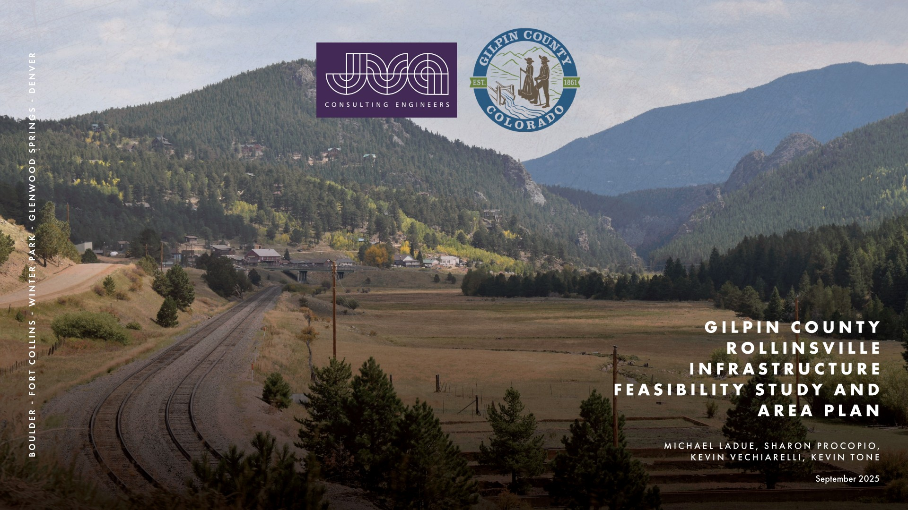
Gilpin County Rollinsville Infrastructure Feasibility Study and Area Plan

Slide 2
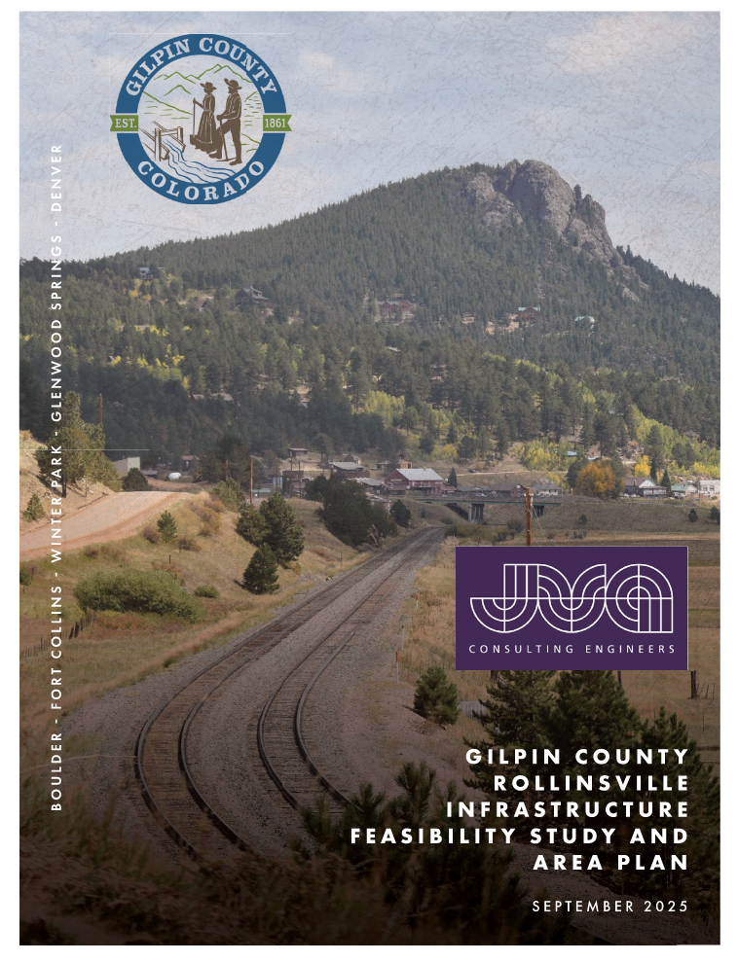
Introduction
Rollinsville Area Specific Plan (ASP)
Limited existing public infrastructure
No fire suppression infrastructure
ASP examines the feasibility of
Water and Fire Suppression Infrastructure
Wastewater Infrastructure
Passenger Rail Station Infrastructure
Stormwater Improvements
Roadway and Access Improvements
Importance of Community Engagement

Slide 3
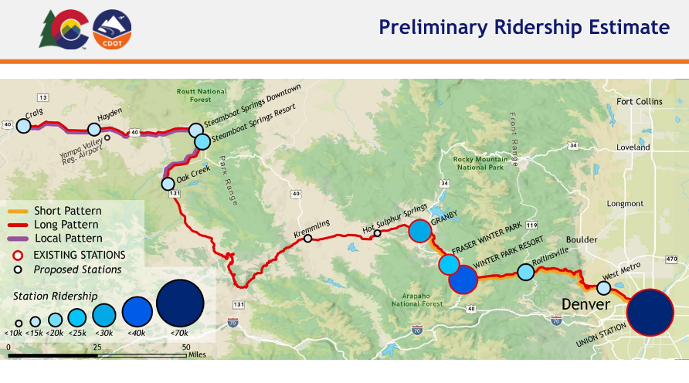
Mountain Rail Plan

Slide 4
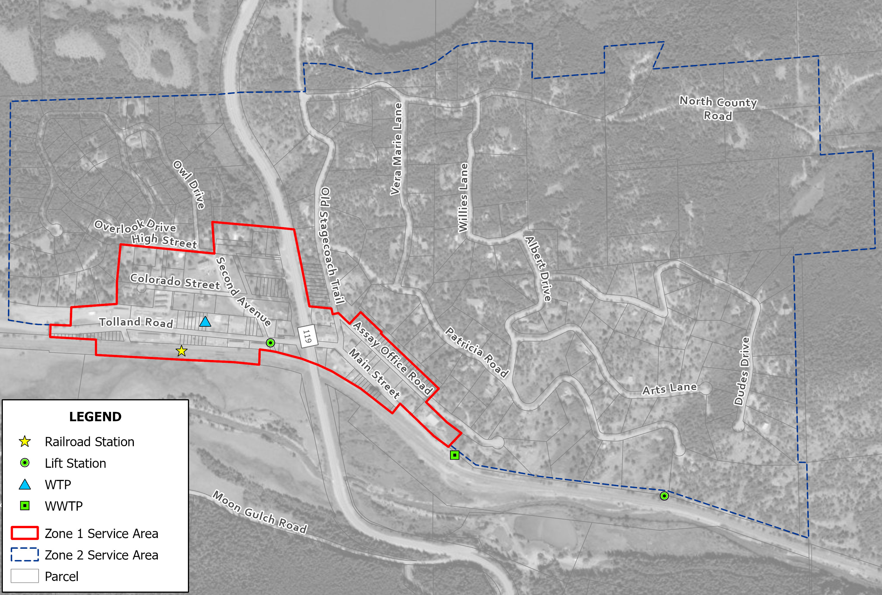
PLANNING CONDITIONS
20-year planning period
Phase 1: Zone 1
Near Term (focus of this ASP)
Phase 2: 20-year projections
Buildout
Zone 1 and Zone 2

Slide 5
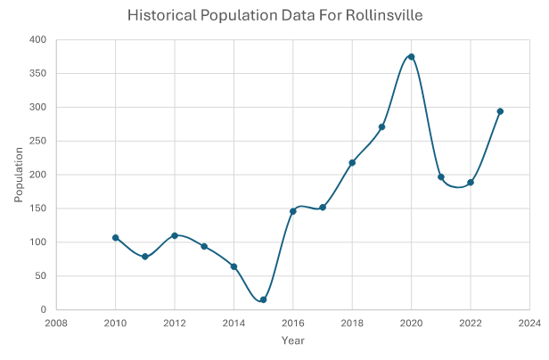
Population Trends
Year | Population from Growth
2023 | 294
2024 | 298
2025 | 303
2026 | 307
2027 | 312
2028 | 317
2029 | 321
2030 | 326
2031 | 331
2032 | 336
2033 | 341
2034 | 346
2035 | 352
2036 | 357
2037 | 362
2038 | 368
2039 | 373
2040 | 379
2041 | 384
2042 | 390
2043 | 396
2044 | 402
2045 | 408
Assumed 1.5 percent growth rate
2045 population = 408

Slide 6
Water Demand
Census Population Analyzed in Service Area
Phase 1 Water Demand
Zone 1 Parcels
Residential and Commercial
Brewery / Distillery
Railroad Station
Outdoor Use
Phase 2 Water Demand
Growth in Zone 2
Buildout
Full Zone 2
Water Demand | Phase 1 (Near Term) | Phase 2 (20-year) | Buildout
Indoor Use - Residential (gpd) | 9,200 | 32,640 | 49,800
Indoor Use - Commercial (gpd) | 12,920 | 15,738 | 19,177
Indoor Use - Railroad Station (gpd) | 3,325 | 3,884 | 3,884
Outdoor Use (gpd) | 2,200 | 4,826 | 6,886
TOTAL (gpd) | 27,645 | 57,088 | 79,747
TOTAL (gpm) | 19 | 40 | 55
PEAK (gpm) | 48 | 92 | 138

Slide 7
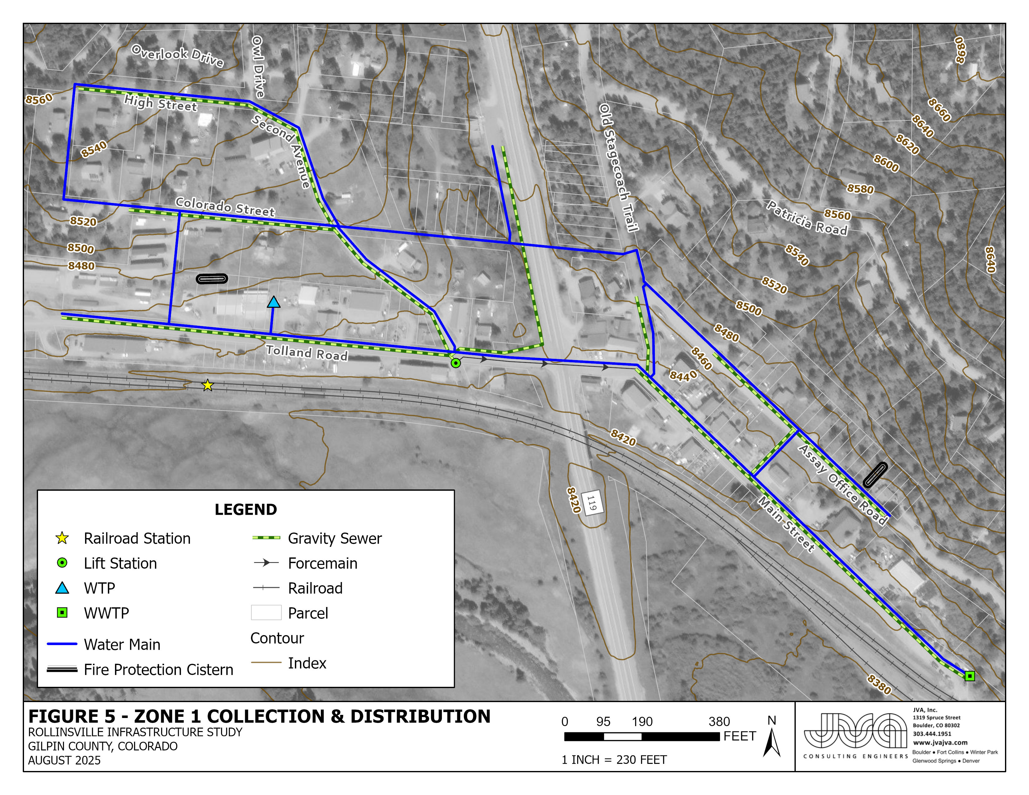
Fire Suppression Water
Timberline Fire Protection District
Two 30,000 Gallon Cisterns
Requirement | Value | Unit | Note
Water Storage - West | 30,000 | gal | From Fire Marshall
Water Storage - East | 30,000 | gal | From Fire Marshall
Water Delivery Rate | 1,000 | gpm | NFPA 1142 - Table 4.6.1

Slide 8
Wastewater Flow
Based on Water Demand – 90 Percent Passthrough
Phase 1 Wastewater Flow
Zone 1 Parcels
Residential and Commercial
Railroad Station
Phase 2 Wastewater Flow
Growth in Zone 2
Buildout Wastewater Flow
Full Zone 2
Sewer Flow | Phase 1 (Near Term) | Phase 2 (20-year) | Buildout
Residential (gpd) | 8,280 | 29,376 | 44,820
Brewery (gpd) | 81 | 81 | 81
Distillery (gpd) | 22 | 22 | 22
Commercial - minus brewery and distillery (gpd) | 11,498 | 14,035 | 17,130
Railroad Station (gpd) | 3,023 | 3,531 | 3,531
TOTAL (gpd) | 22,904 | 47,044 | 65,583

Slide 9
Wastewater Loading
Assumptions
Brewery / Distillery
Biochemical Oxygen Demand (5‑day, BOD₅)
Loading Projection (lbs/day BOD5) | Phase 1 (Near Term) | Phase 2 (20-year) | Buildout
Residential | 13.8 | 49.0 | 74.8
Brewery | 1.3 | 1.3 | 1.3
Distillery | 4.6 | 4.6 | 4.6
Commercial - minus brewery and distillery | 19.2 | 23.4 | 28.6
Railroad Station | 5 | 6 | 6
TOTAL | 44 | 84 | 115
Assumption | Value | Unit | Note
BOD₅ of Residential Wastewater | 200 | mg/L | Metcalf & Eddy Table 3-18, Medium Strength
BOD₅ of Typical Commercial Wastewater | 200 | mg/L | Metcalf & Eddy Table 3-18, Medium Strength
BOD₅ of Brewery Wastewater¹ | 2,000 | mg/L | Ranges from 1000-2000 mg/L
BOD₅ of Distillery Wastewater² | 25,000 | mg/L
BOD₅ of Railroad Station Wastewater | 200 | mg/L | Metcalf & Eddy Table 3-18, Medium Strength
Notes:
References for assumptions
BOD5 of Brewery Wastewater: Brewers Association. (2013). Water and wastewater: Treatment/volume reduction manual. Brewers Association. Retrieved from https://cdn.brewersassociation.org/wp-content/uploads/2017/05/Sustainability_Water_Wastewater.pdf
BOD5 of Distillery Wastewater: Dalkita. (2018, October 26). Distillery wastewater & BOD’s. Retrieved from https://dalkita.com/distillery-wastewater-bods/

Slide 10
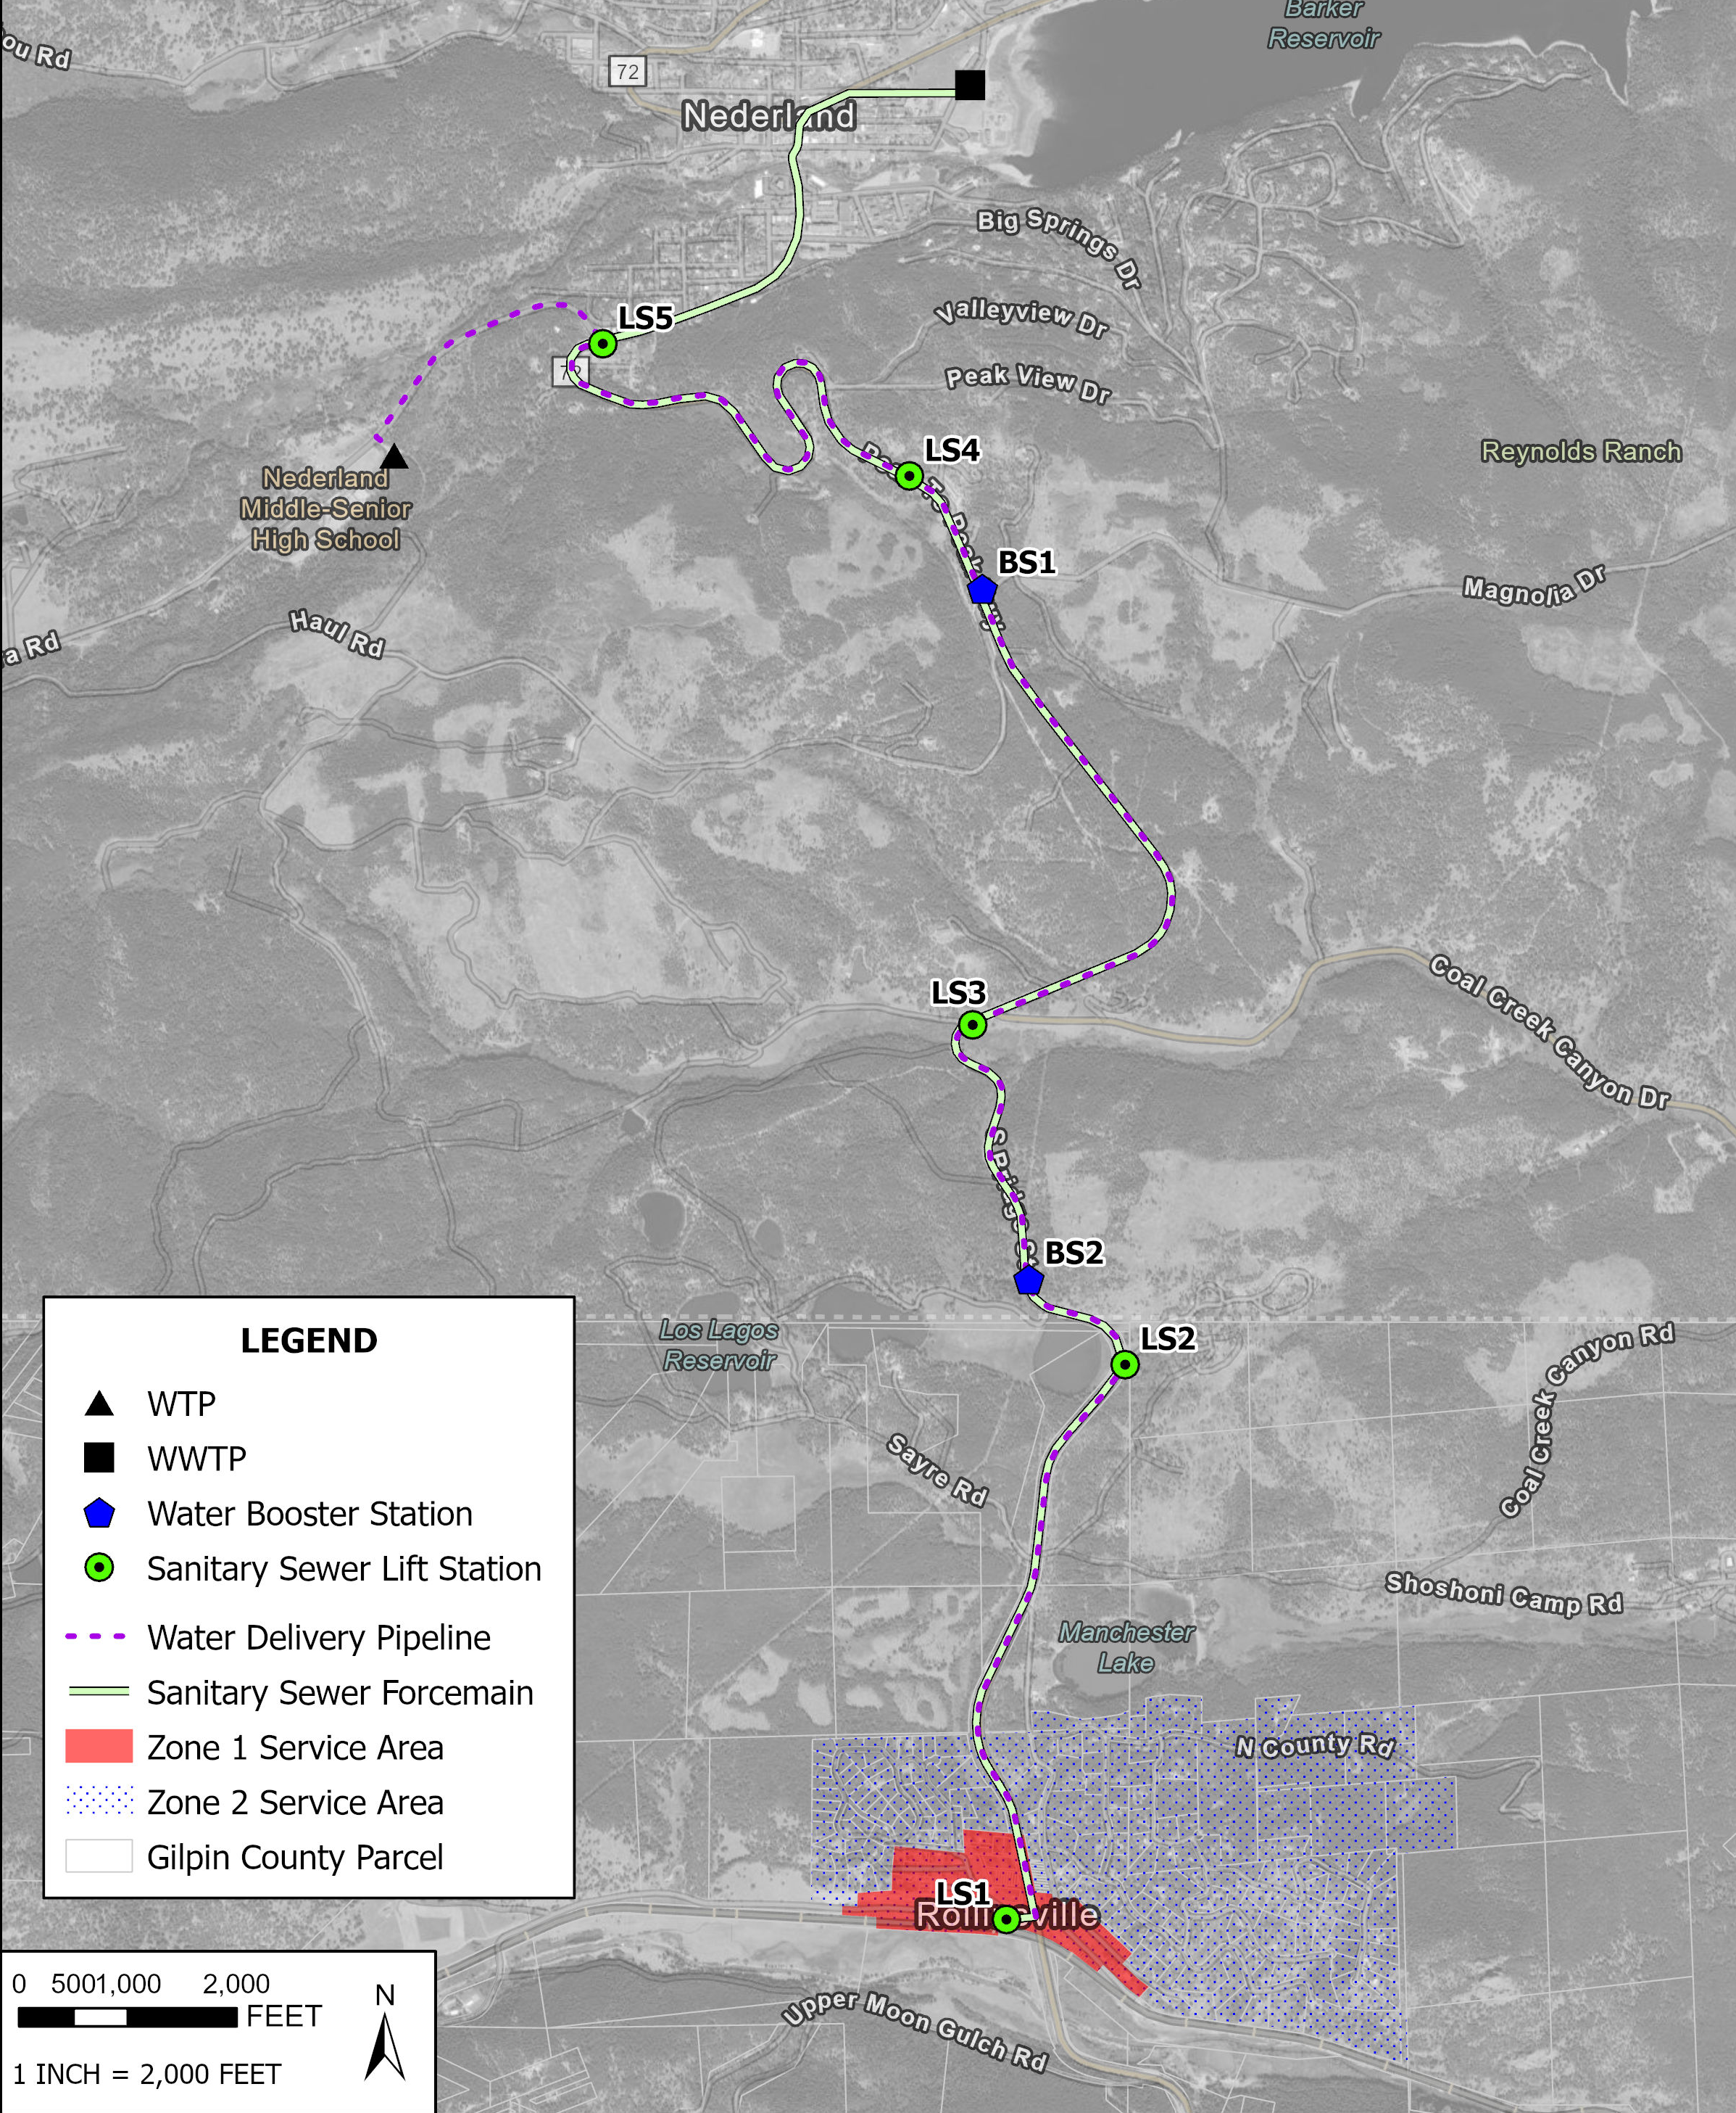
Water System Alternatives - Consolidation
Water Consolidation: $24 million
25,000 linear feet (LF) of water pipe
2 Booster stations
Plant Investment Fee
Wastewater Consolidation: $17.5 million
26,500 LF of force main
5 Lift Stations
Plant Investment Fee
Total: $41.5 million

Slide 11
Water System Alternatives – Water Rights
Source Water Considerations
Surface Water Diversion
Freezing, stream variability
Groundwater Diversion
Cluster of wells (≈10 gpm each)
Legal Considerations
New Depletion on South Boulder Creek
Lease agreement / purchase of other water rights

Slide 12
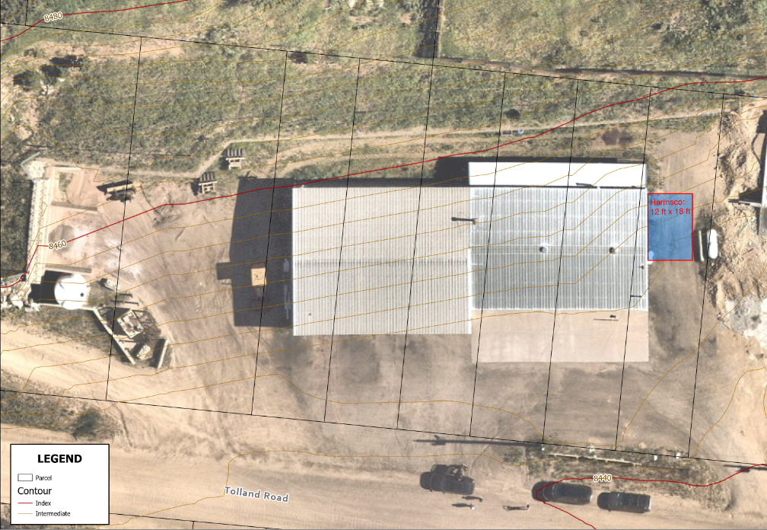
Water system Alternatives - WTP
Source Water Development – Wells
Water Quality Considerations
Raw Water Storage
Filtration Alternatives
Harmsco Cartridge
MEMCOR Membrane
Disinfection
Finished Water Storage

Slide 13
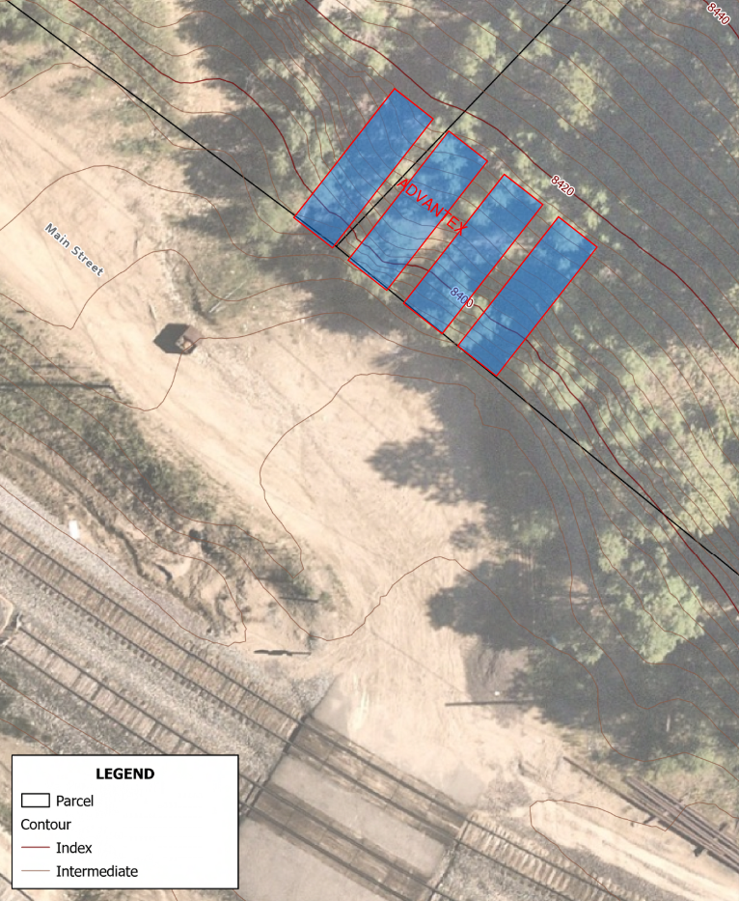
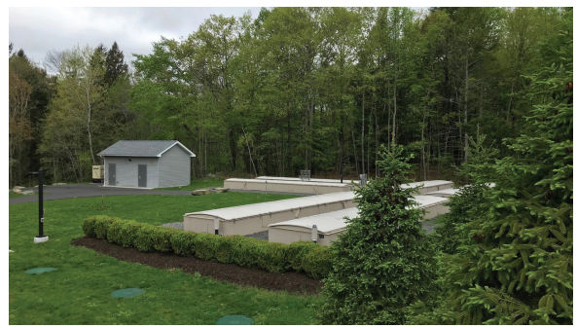
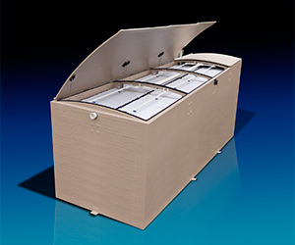
Wastewater system Alternatives - WWTP
New Discharge Permit through CDPHE
Effluent limitations
WWTP Alternatives:
Sequencing Batch Reactor
Membrane Bioreactor (Cloacina MEMPAC-X)
Packed Bed Filter (Orenco AdvanTex)
Outfall to South Boulder Creek
Example AdvanTex installations from Orenco’s website

Slide 14
Water Distribution / Wastewater Collection – Zone 1
Zone 1 Water Distribution
7,500 LF of water main (4-inch PVC C900)
107 Active Parcels & service assemblies
Zone 1 Wastewater Collection
5,700 LF of gravity sewer (8-inch SDR 35 PVC)
500 LF of force main (4-inch HDPE and 1 lift station)
25 Manholes

Slide 15
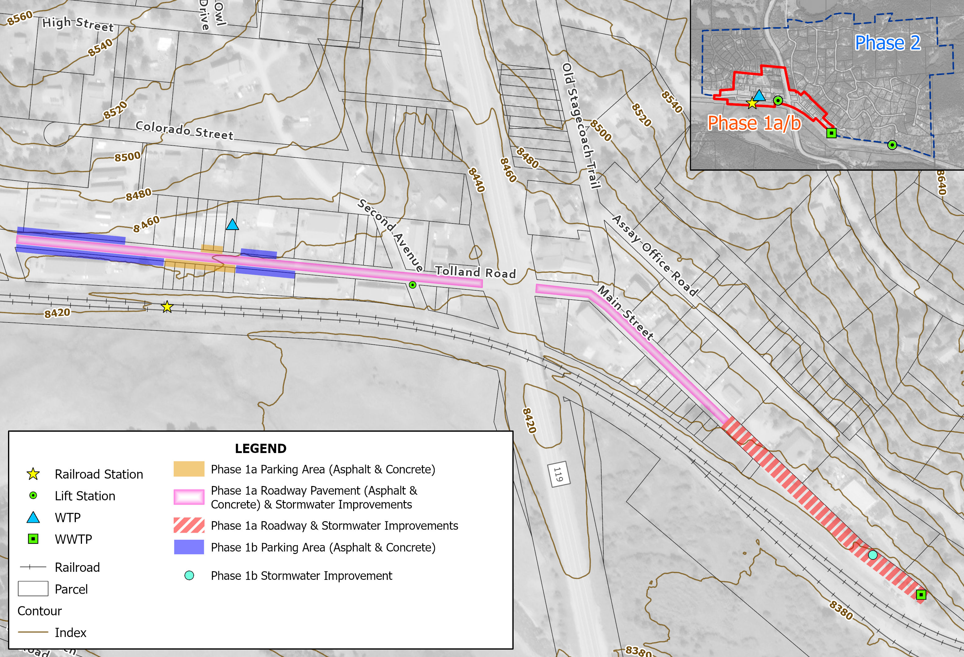
Overall phase 1 civil site improvements
Rail station
Roadway and Parking
Stormwater
Pedestrian Crossing

Slide 16
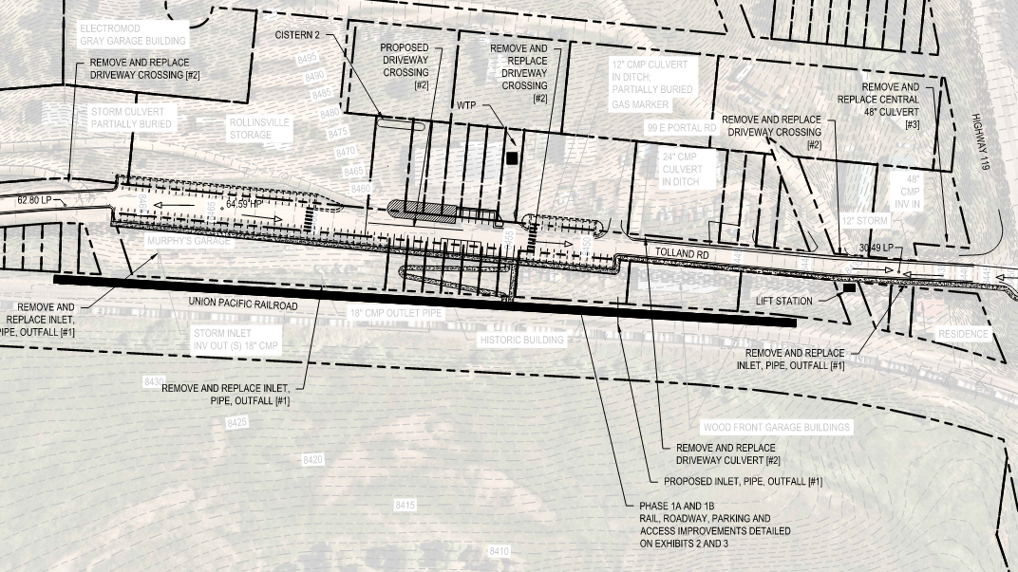
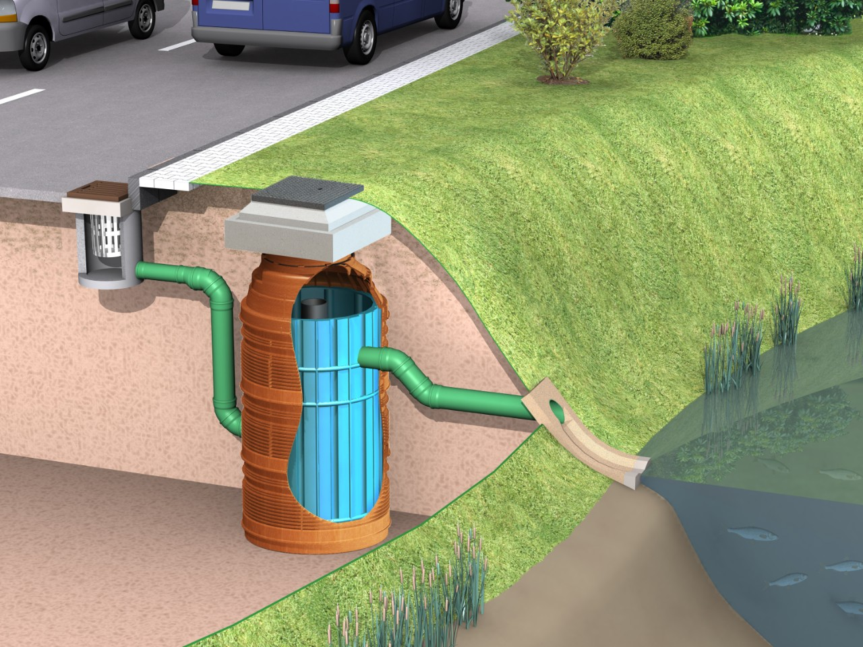
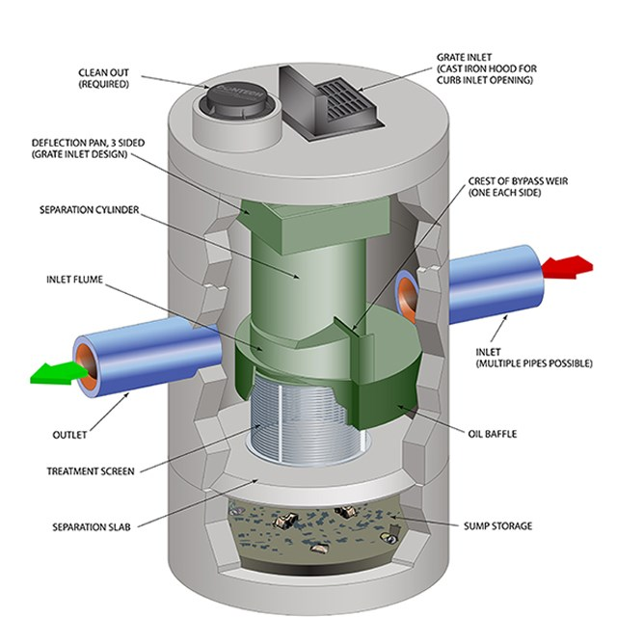
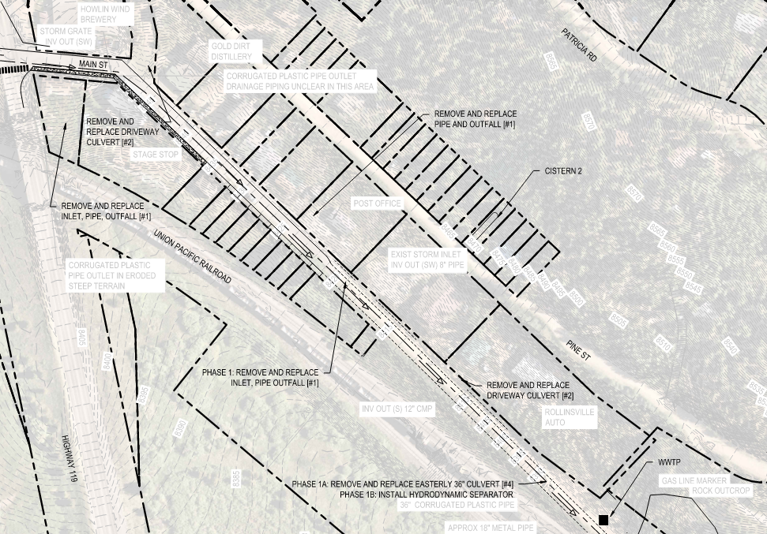
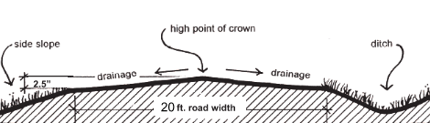
Stormwater concept overall
Hydrodynamic Separator
Stormwater crossing upgrades
Water quality treatment
Outfall erosion control
Roadside ditches and swales

Slide 17
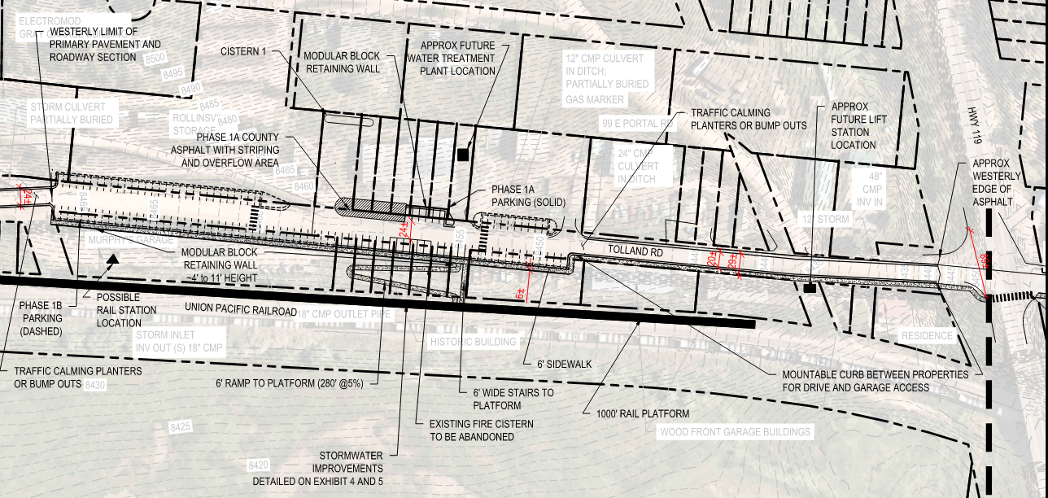
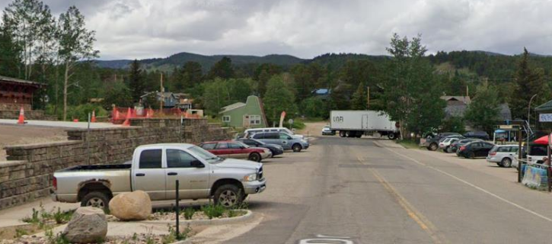
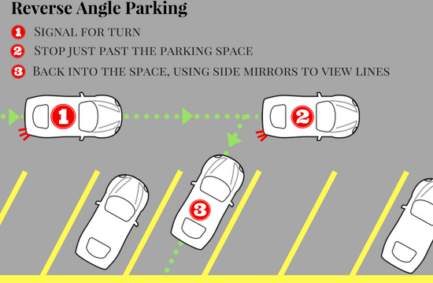
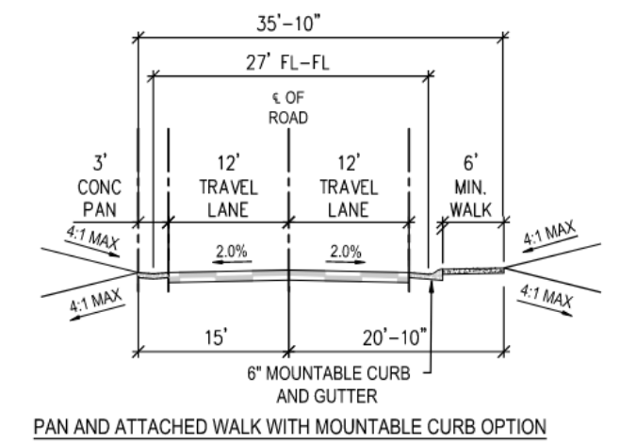
Transportation concept Tolland Rd
Rail station platform
ADA access, ramps, depot
Parking
Head-in vs angled
Sidewalks, traffic calming
County facility access

Slide 18
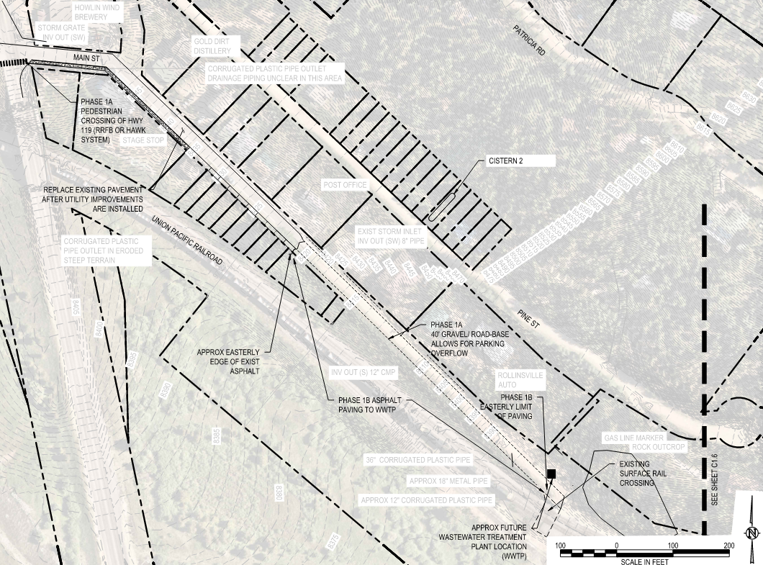
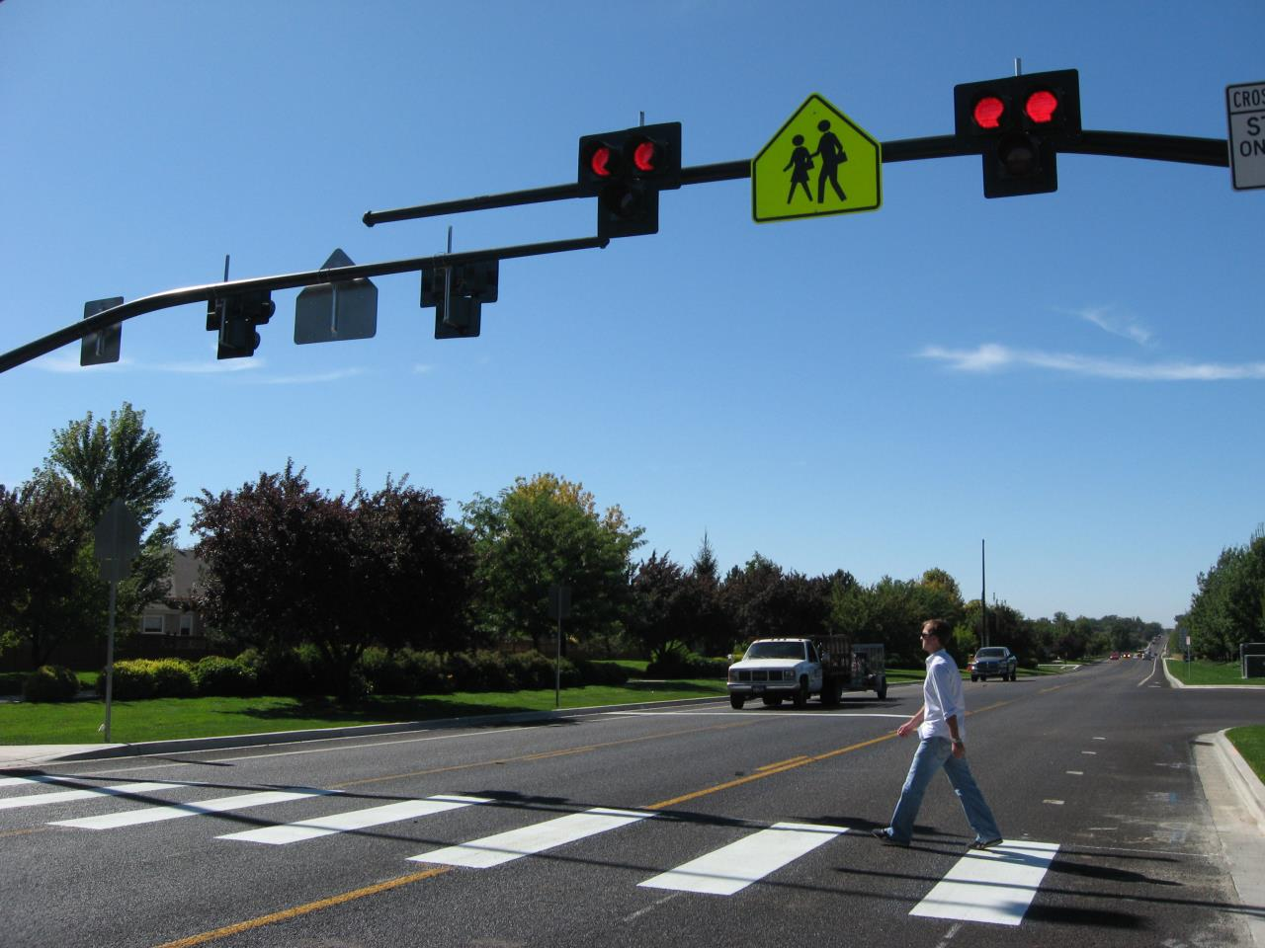

Transportation concept Crossing and Main St
Gravel in Phase 1a to WWTP
Allow should parking width
Pedestrian safety
Sidewalks coord w/ business owners
HAWK or RRFB crossing system for CO-119
Update parking and pavement as community need arises
HAWK
RRFB
Notes:
HAWK = High‑Intensity Activated crossWalK
RRFB = Rectangular Rapid Flashing Beacon

Slide 19
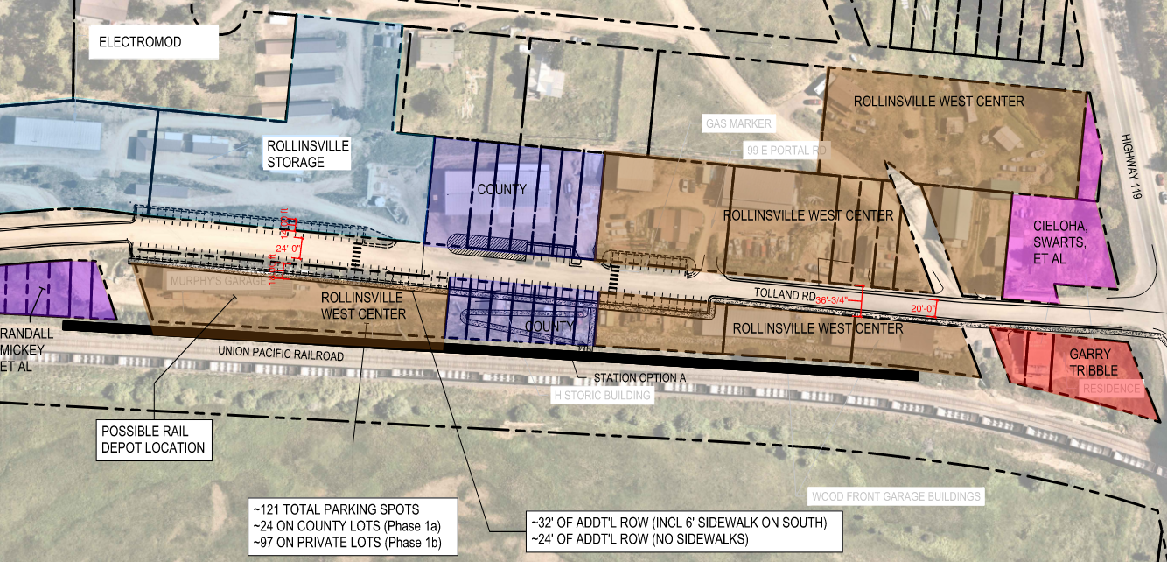
Right-of-way and parcel ownership

Slide 20
Capital Improvements Plan – Phase 1
Phase 1 CIP
Water: $5 – $8 M
Wastewater: $5 – $8 M
Stormwater: $0.4 – $0.6 M
Transportation: $3 – $5 M
Phase 1 Water Capital Improvement Project | Subtotal | Total OPC
Fire Cisterns | $360,000 | $647,000
Source Water Diversion – 2x 15 gpm Wells | $520,000 | $934,000
Harmsco Cartridge Filtration Water Treatment Plant | $734,600 | $1,329,600
Zone 1 Water Distribution System | $2,694,000 | $4,828,000
TOTAL |  | $7,738,600
Phase 1 Wastewater Capital Improvement Project | Subtotal | Total OPC
Zone 1 Collection System | $3,045,000 | $5,456,000
Orenco AdvanTex WWTP and Effluent Line | $1,278,500 | $2,313,500
TOTAL |  | $7,769,500
Phase 1a and 1b Stormwater Capital Improvement Project | Total OPC
Package #1: Roadway Crossing (Inlet, HDS, 50' Crossing, Outfall) | $85,100
Package #2: Driveway Crossing (FES, 30' Crossing, FES, riprap) | $20,900
Package #3: Central 48" Crossing (Immediately west of Highway 119) | $70,500
Package #4: Easterly 36" Crossing (East end of site by Rollinsville Auto) | $63,000
Add Hydrodynamic Separator to Easterly 36" Crossing (Phase 1b) | $40,000
Subtotal | $279,000
General Conditions, Contingency, Engineering, Permitting, OH&P, Bidding, CA | $224,000
TOTAL | $503,500
Phase 1a and 1b Transportation Capital Improvement Project | OPC
Roadway Paving | $550,000
Parking stalls (121 total) | $250,000
Concrete Sidewalks, Pans, Curb & Gutter | $275,000
Site Modular Retaining Walls | $400,000
HAWK Crossing system (RRFB as an alternative is $50,000-$75,000) | $350,000
Rail Station ADA Accessible Ramp, handrails, side stairs | $175,000
Rail Station Platform | $750,000
Subtotal | $2,750,000
General Conditions, Contingency, Engineering, Permitting, OH&P, Bidding, CA | $2,177,000
TOTAL | $4,927,000

Slide 21
Funding
State Revolving Fund (SRF) Disadvantaged Status
Available Funding Opportunities
Summary of SRF Disadvantaged Status (Primary Factors)
Metric | Community of Rollinsville (Margin of Error) | Disadvantaged Community Requirement | Metric Met?
Median Household Income | $108,14 (-52,419) | <= $73,976 | No
Median Home Value | $602,200 (-47,095) | <= $502,200 | No
Unemployment Percentage | 3.10% | >= 4.47% | No
Summary of Available Funding Opportunities
Funding Opportunity | Organization(s) | Deadline(s) | Amount Available | Requirements
User Fees and Tap Fees | Special District | - | TBD | -
State Revolving Fund Loan | CDPHE, WQCD, DOLA, & Authority | January 5th, February 5th, April 5th, June 5th, August 5th, and November 5th | Varies for DWRF & WPCRF | See SRF report section
EIAF Administrative Grant | DOLA | April 1st, August 1st, December 1st | $25,000 | Dollar-for-dollar match
EIAF Tier I Grant | DOLA | April 1st, August 1st, December 1st | $200,000 | Dollar-for-dollar match
EIAF Tier II Grant | DOLA | April 1st, August 1st, December 1st | $200,000 to $1,000,000 | Dollar-for-dollar match
Flood and Drought Response Fund | CWBD | None | Varies | -
Water Project Loan Program | CWCB | Varies | Varies | -
Water Plan Grants | CWBD | Varies | Varies | 50% Match
Emergency Community Water Assistance Grants | USDA Rural Development | Varies | $150,000 or $1,000,000 | -
Direct Grants and Loans | USDA Rural Development | None | Varies | -
WaterSMART Water and Energy Efficiency Grants | USBR | Varies | $500,000 or $5,000,000 | 50% match
WaterSMART Drought Resiliency Projects | USBR | Varies | $3,000,000
(Local IMPACT) Accelerator | Colorado Energy Office | Oct 1 - Nov 17 | $200,000/ policy + $1,800,000/ implement | 5% match

Slide 22
Next Steps
Next Steps
Community Engagement and Finalize Report
Timeline
October 1, 2025 at 6:00 PM: Virtual Public Meeting
October 9, 2025 at 6:00 PM: In-Person Public Meeting at Howlin Wind Brewing
October 14, 2025 at 7:00 PM: Virtual/In-Person Meeting with Planning Commission
A presentation of the final report will occur at a future Planning Commission meeting

Slide 23
QUESTIONS?

